Slide 1


SLHS-SIM
Design Lead - Devika Pradhan Liaison- Michael Wu
Programmer-Hang Yang
Programmer-Taoyue Zhang
Spring 2015 Final Design Review

Slide 2
Partners
In coöperation with the Purdue Department of Speech, Language, and Hearing Sciences (SLHS)
Primary contacts:
Barbara Cicholski, M.A. (Speech and language pathology)
Anu Subramanian, Ph. D. (Clinical associate professor; Speech and language pathology)

Slide 3
Main Goal
To design and implement an online simulation of the PPVT-IV exam to train test proctors and help subjects prepare for the actual exam.

Slide 4
What is the PVVT-IV?
Peabody Picture Vocabulary Test Fourth generation (PPVT-IV) for students studying in SLHS-related fields to practice administering this exam
This test administers the level of understanding and critical thinking of those with learning disability.

Slide 5
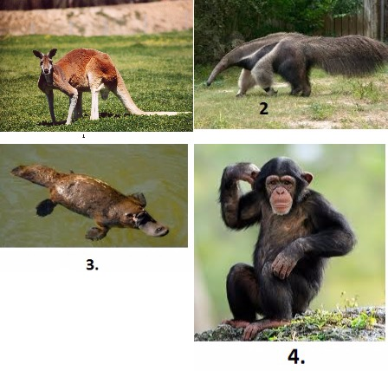
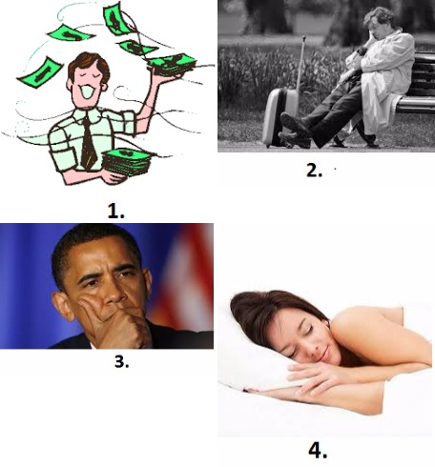
Example…
Which of the following is a primate?
Which picture depicts pensive?

Slide 6
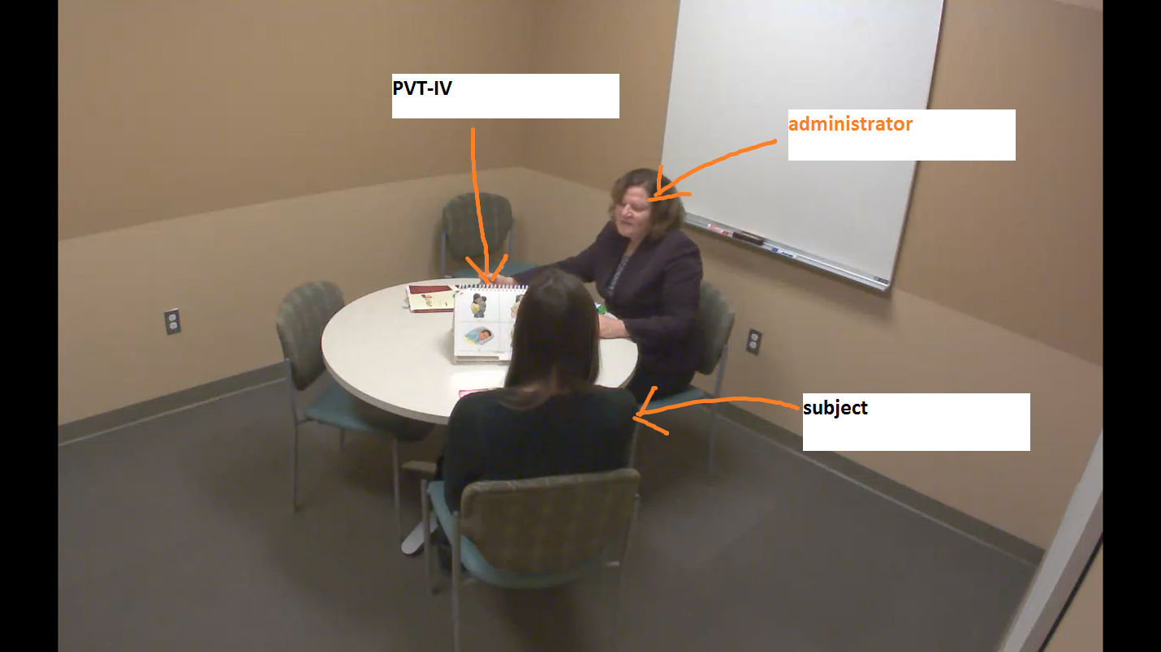

Slide 7
Objectives
Create an online database for storing the videos, forms, and answers
Fully implement scoring features and user feedback
Viewers get an idea of how the actual test is administered.

Slide 8
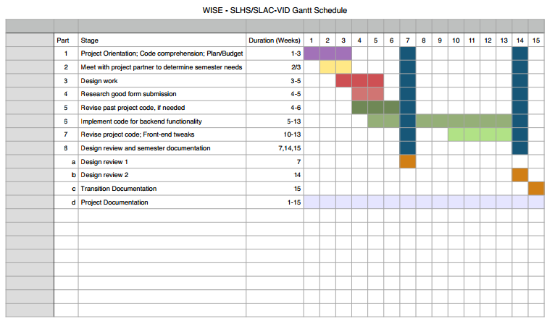
Timeline

Slide 9
Progress
Got the PPVT-4 forms and videos fully understood for coding
Implemented basic features as project partner required
Add pop ups to time stamps to show answers.
Have a database to record responses.

Slide 10
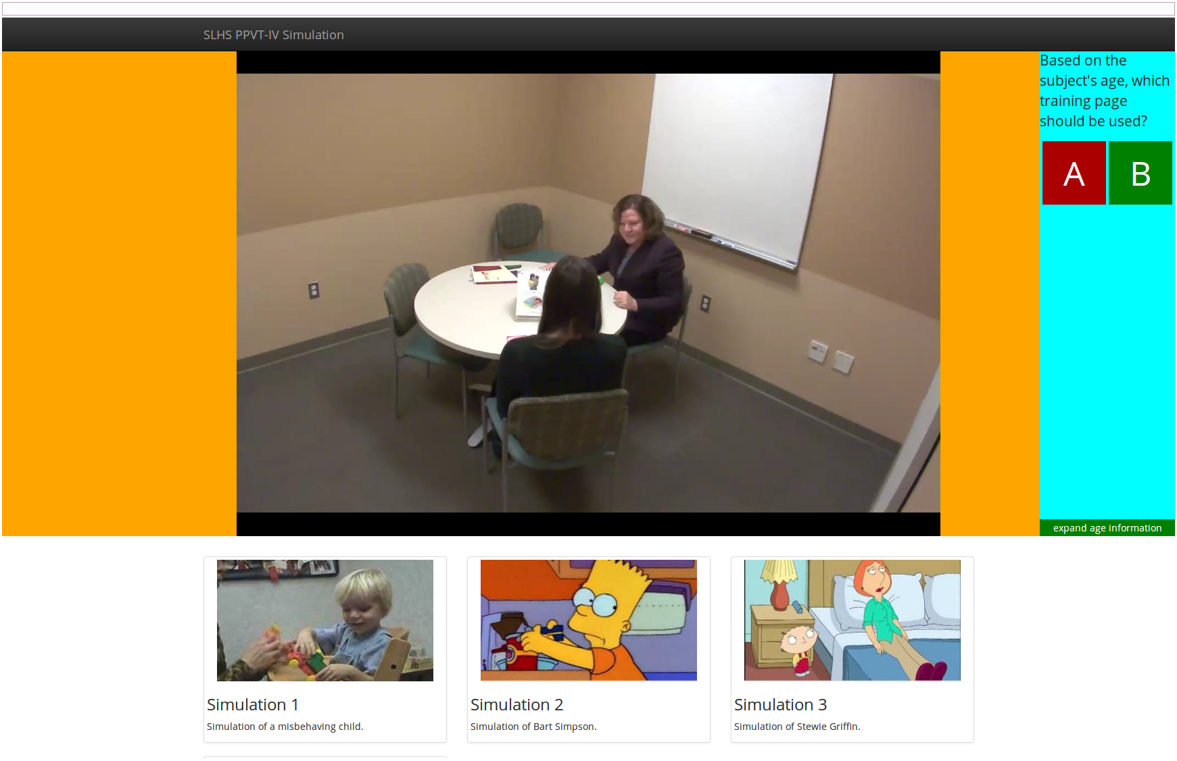
Simulation Slides

Slide 11
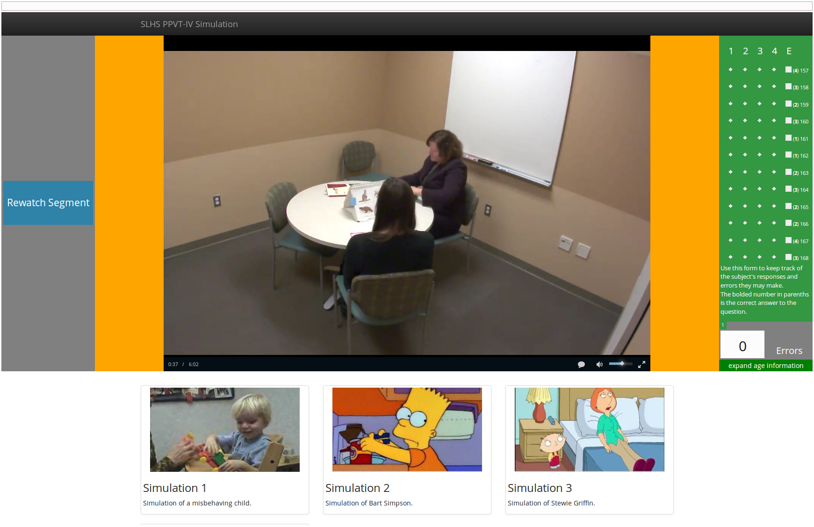

Slide 12
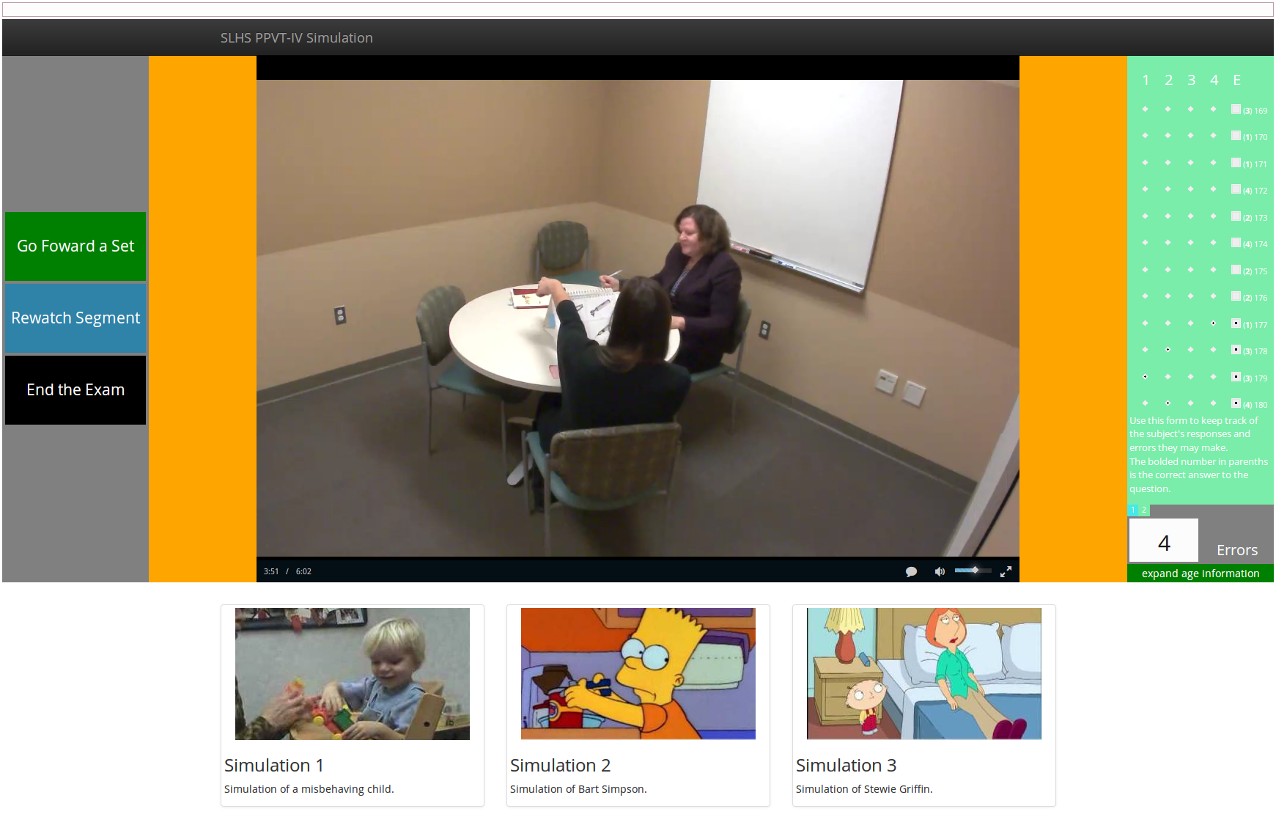
Next Test Set
Set is repeated if there are more than 7 errors.

Slide 13
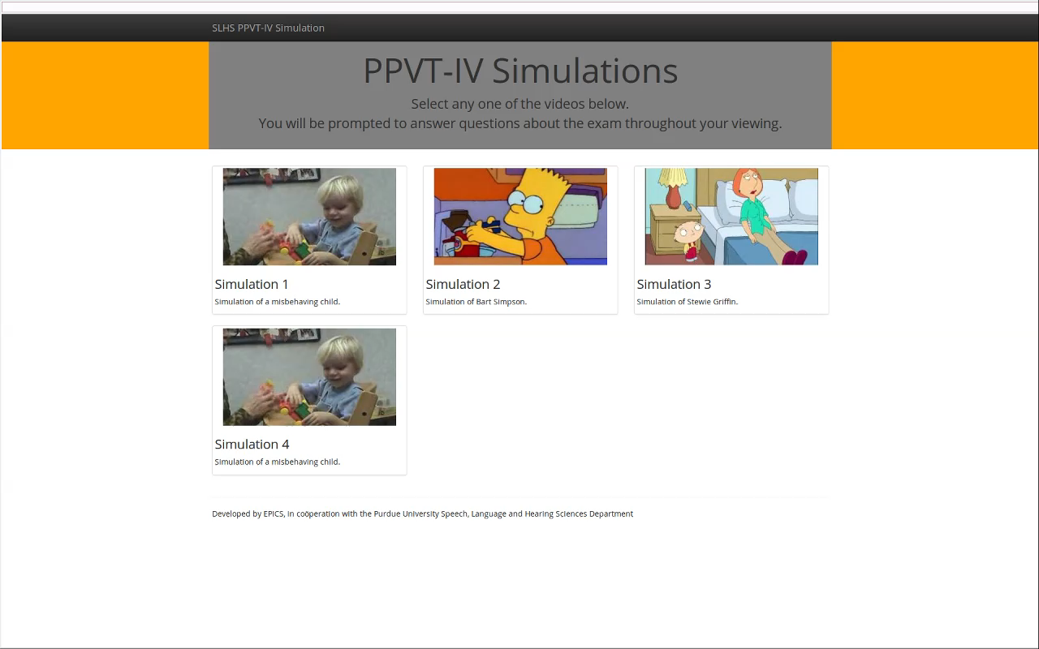

Slide 14
Specs of the Simulation and Code
The time stamps are flexible
The simulation records user responses to give performance feedback, but most importantly reinforces concept by informing the student of incorrect responses

Slide 15
Subject can review segments of the simulation before choosing to progress or regress
Integrates jQuery and Javascript using online standard libraries, although the goal is eventually to eliminate all the but the most necessary (jQuery and bootstrap)

Slide 16
Technology Credits
jQuery
JavaScript
HTML5/CSS3
videojs
bootstrap

Slide 17
SWOT Analysis
Strengths
We made the site more user friendly and flexible for the subject to experiment with.
Weaknesses
The simulation doesn’t incorporate all the constraints like age, number of past attempts in consideration, etc.
Opportunities
We can add the same features to all the other sets of a given form.
Threats
For better results, we need all members to become proficient with coding

Slide 18
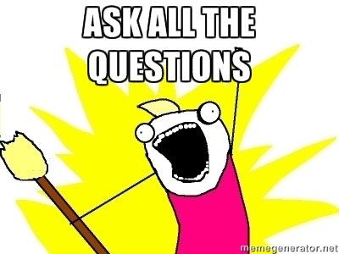
Q&A Forum

Slide 19
THANK YOU

